Slide 1
The Research Process: A Quick Glance
Kumar: Research Methodology Chapter 2
Prepared by Stephanie Fleischer
authored by Stephanie Fleischer © SAGE publications Ltd 2014

Slide 2
Topics covered
The eight step model for carrying out research:
Phase I: DECIDING what to research
Step I: Formulating a research problem
Phase II: PLANNING a research study
Step II: Conceptualising a research design
Step III: Constructing an instrument for data collection
Step IV: Selecting a sample
Step V: Writing a research proposal
Phase III: CONDUCTING a research study
Step VI: Collecting data
Step VII: Processing and displaying data
Step VIII: Writing a research report
authored by Stephanie Fleischer © SAGE publications Ltd 2014

Slide 3
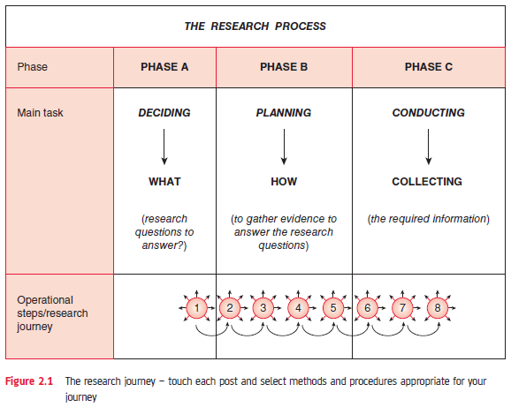
Figure 2.1 The research journey
authored by Stephanie Fleischer © SAGE publications Ltd 2014

Slide 4
The research process
Methodologies differ due to underpinning philosophy
The process is the same for quantitative and qualitative research
Each approach uses different research methods for data collection, data processing, analysis and style of communicating the findings
authored by Stephanie Fleischer © SAGE publications Ltd 2014

Slide 5
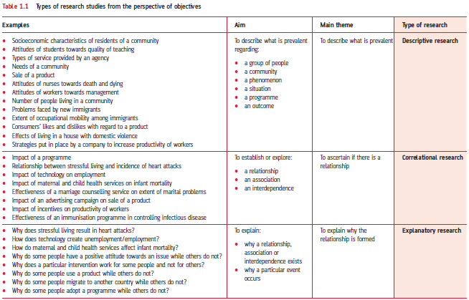
Table 1.1 Differences between qualitative and quantitative research
authored by Stephanie Fleischer © SAGE publications Ltd 2014

Slide 6
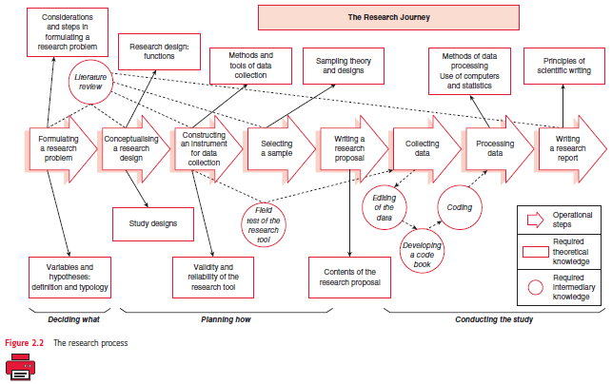
Figure 2.2 The research journey
authored by Stephanie Fleischer © SAGE publications Ltd 2014

Slide 7
Phase I: DECIDING what to do
Step I: Formulating a research problem
Most important step, because the following steps are influenced by the research problem
What do you want to find out about?
Have you got sufficient funds to do the research?
Have you got the time available to conduct the study?
Have you got knowledge of relevant disciplines?
Do you have sufficient knowledge of skills needed?
authored by Stephanie Fleischer © SAGE publications Ltd 2014

Slide 8
Phase II: PLANNING a research study
Step II: Conceptualising a research design
What you find depends on how it was found
Select an appropriate research design:
Quantitative
Qualitative
Mixed methods
The design has to be
Valid
Workable
Manageable
Be aware of its strengths and weaknesses
authored by Stephanie Fleischer © SAGE publications Ltd 2014

Slide 9
Phase II: PLANNING - continued
Step III: Constructing an instrument for data collection
How will you collect your data?
Construct a research instrument or research tool to collect data (interview schedules, questionnaires, notes on observations, diaries, interview guides, etc.)
Or use secondary data (information already collected for other purposes)
Do a pre-testing of your research tool (pilot study)
authored by Stephanie Fleischer © SAGE publications Ltd 2014

Slide 10
Phase II: PLANNING – continued
Step IV: Selecting a sample
Who will take part in your research?
Select appropriate sample/participants to represent the study population
Avoid bias
Random / probability samples
Non-random / non probability samples
Be aware of strengths and weaknesses of different sampling methods
authored by Stephanie Fleischer © SAGE publications Ltd 2014

Slide 11
Phase II: PLANNING - continued
Step V: Writing a research proposal
Write a detailed plan about your research:
What are you proposing to do?
How you plan to proceed?
Why you select the proposed strategy?
authored by Stephanie Fleischer © SAGE publications Ltd 2014

Slide 12
Phase III: CONDUCTING a research study
Step VI: Collecting data
Doing the data gathering using one or more data collection method, such as:
conducting interviews
mailing out questionnaires
conducting nominal/focus groups discussions
making an observation
Be aware of ethical issues!
authored by Stephanie Fleischer © SAGE publications Ltd 2014

Slide 13
Phase III: CONDUCTING - continued
Step VII: Processing and displaying data
What did you find how?
Analysing the data depends on the type of information and how to communicate the findings
Distinguish between
Descriptive
Quantitative (statistical procedures)
Qualitative (narrative, content analysis)
Attitudinal
authored by Stephanie Fleischer © SAGE publications Ltd 2014

Slide 14
Phase III: CONDUCTING - continued
Step VIII: Writing a research report
What have you done? What conclusions have you drawn from the findings?
Different format for quantitative and qualitative research
Structure using main themes of study
Use academic conventions
authored by Stephanie Fleischer © SAGE publications Ltd 2014

